Slide 1
Amazon Web Services

Slide 2
ToC - Agenda
Introduction to AWS?
AWS Services
        Amazon VPC(Virtual Private Cloud)
        Amazon Route 53
        Amazon Direct Connect
        Amazon EC2(Elastic Compute Cloud)

Slide 3
AWS VPC
Introduction to VPC
Subnets
Route Tables
Security Groups
VPC modules

Slide 4
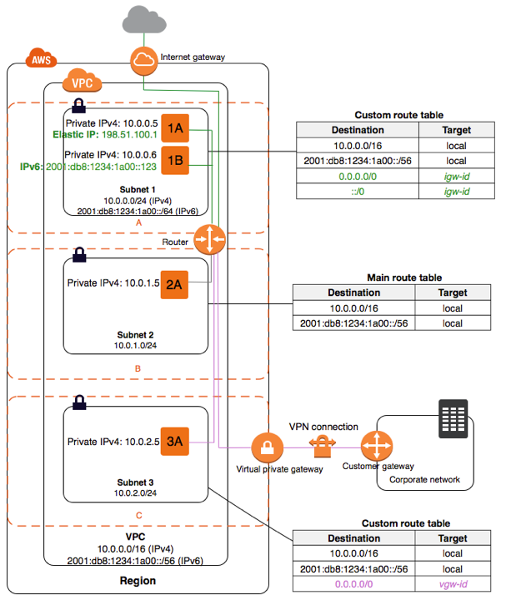

Slide 5
Amazon Route 53
What is Amazon Route53?
Why Amazon Introduce Amazon Route 53
Routing Policies
Important Features
Key Benefits

Slide 6
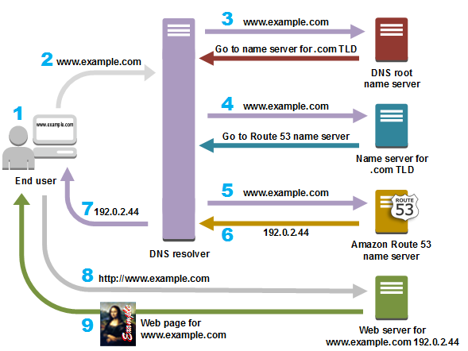
Hands on

Slide 7
AWS Direct Connect
What is AWS Direct Connect(DX)?
Why AWS Direct Connect?
How is DX different from a VPN?
Direct Connect Connections
Direct Connection Benefits

Slide 8
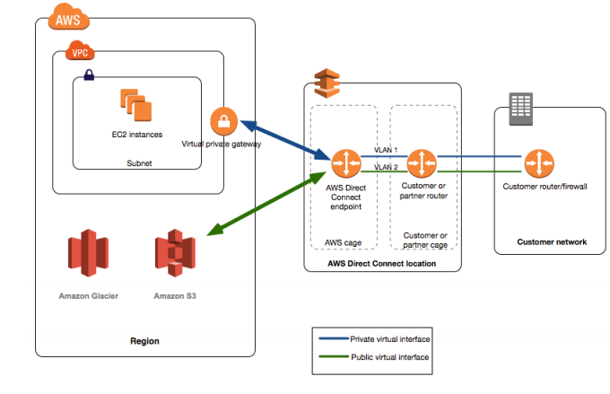
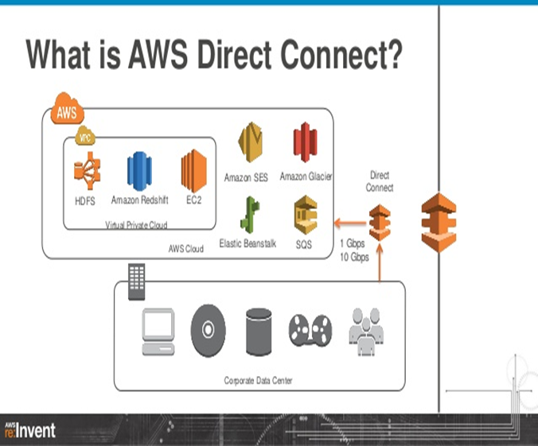
The following diagram shows how AWS Direct Connect interfaces with your network

Slide 9
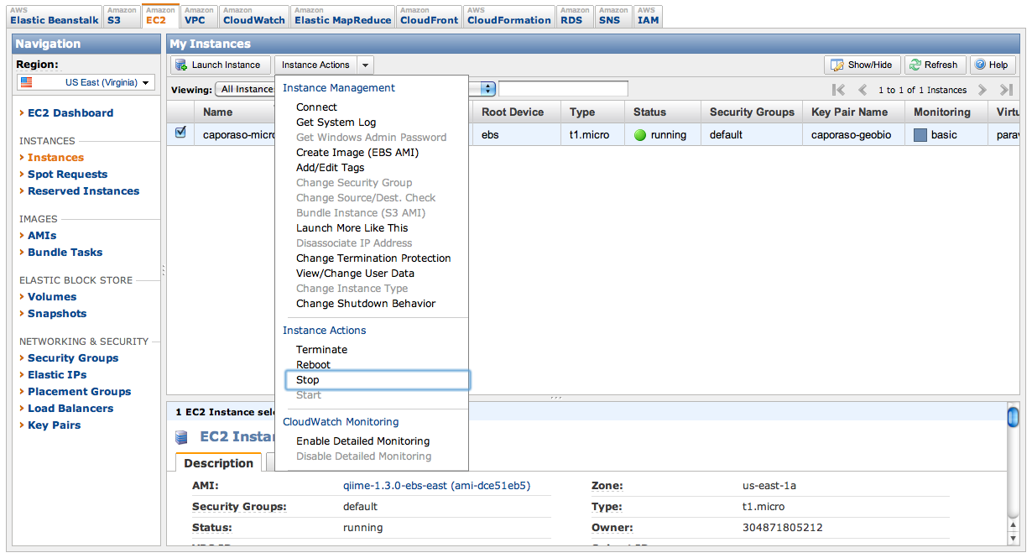
Amazon EC2(Elastic Compute Cloud)
Introduction to Amazon EC2
Amazon EC2 Cost Models
Amazon EC2 Instances

